Slide 1
1961 quiz
ANSWERS

Slide 2
1961 Quiz
What new information was gathered in the census of April 23rd 1961
The first murder to be solved by a unique method of identification, what was it?
Who was the original Dr. Kildare?
Which actor played the male love interest in Breakfast at Tiffany’s
What film did Elizabeth Taylor win a leading actress Oscar this year?
Who won the Ladies Wimbledon singles championship?
What popular sweets were ‘Made to make your mouth water’?
Who was Widely regarded as one of the greatest drivers to never win the Formula One World Drivers' Championship,
Which 14 year old scored 2 no.1 hits?
Which 3 nations became independent from Britain in 1961

Slide 3
What new information was gathered in the 1961 census
Qualifications,
migration,
household tenure.
The first time a computer was used - an IBM 705 at the Royal Army Pay Corps, Worthy Down, Winchester, England .

Slide 4
What new information was gathered in the 1961 census
The 1961 census revealed a major demographic turning point for the UK. It showed that post-war immigration from across the Commonwealth was reshaping the population, with just over 161,000 people born in the Caribbean living in England and Wales. Internal Migration:
It was the first census to ask where the head of the household was resident exactly one year prior to the census. [1]
County of Birth: This was the last time the census asked for the "county of birth" to measure internal migration among the British-born population. [1]
Commonwealth Migration: It was the first census to explicitly capture the scale of migration from Commonwealth countries, including those who arrived from the Caribbean, Asia, and Oceania. [1]
Held on April 23, 1961, the United Kingdom Census of 1961 counted 52,861,251 people, with 46,104,548 in England and Wales. (22,303,833 males and 23,800,715 females).
Demographics reflected a post-war society: 68% of people aged 16 and over were married, and households were highly centralized around traditional family units and basic housing, with 28% of homes privately rented
Housing Tenure: 28% of households were in private rented accommodation, and 24% rented from a local authority or New Town corporation

Slide 5
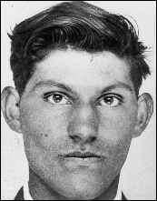
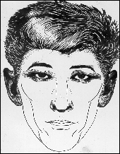
The Antique shop murder solved using IDENTIKIT rendition of suspected person

Slide 6
The antique shop murder 2/3/1961
Edwin Bush was looking for a present
Elsie Batten showed him a dagger - £15 – she was stabbed a number of times and left
Shop owner – Mr Meier found her. Police ascertained he recalled a youth asking after the same dagger and provided an IDENTIKIT
IDENTIKIT also provided by another shop owner
Edwin was identified by PC Cole in London 8th March
Confessed
Hanged in Pentonville 6th July 1961 – the last man

Slide 7
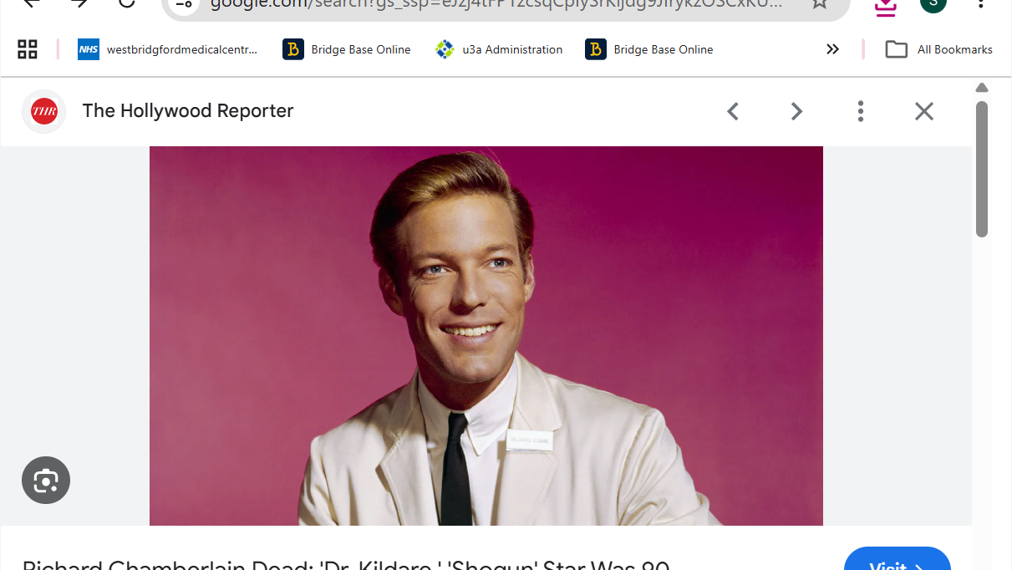
Q3 who was the original Dr Kildare?

Slide 8

Richard Chamberlain – Major Roles
American actor (1934–2025) who became a 1960s teen idol in the title role of TV’s Dr. Kildare (1961–66), across 191 episodes.
Dubbed the “King of the Miniseries” for Centennial (1978), Shōgun (1980) and The Thorn Birds (1983) as Father Ralph – a Golden Globe-winning role.
Big-screen star as Aramis in The Three Musketeers (1973–74) and in the disaster epic The Towering Inferno (1974).
Title lead in The Count of Monte Cristo (1975) and adventurer Allan Quatermain in King Solomon’s Mines (1985).
First actor to play Jason Bourne, in the 1988 TV film The Bourne Identity; winner of three Golden Globes across a 60-year stage and screen career.

Slide 9
4 Which actor played the love interest in Breakfast at Tiffany’s

Slide 10
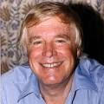
George Peppard – Major Roles
American actor (1928–1994) who broke through as struggling writer Paul Varjak opposite Audrey Hepburn in Breakfast at Tiffany’s (1961).
Leading man in the epic blockbusters How the West Was Won (1962) and The Carpetbaggers (1964), playing a Howard Hughes-inspired tycoon.
Starred as an obsessive fighter pilot in the World War I aviation drama The Blue Max (1966).
Played the title role of suave insurance investigator Thomas Banacek in the early-1970s mystery series Banacek.
Found renewed fame as cigar-chomping Col. John “Hannibal” Smith, leader of The A-Team (1983–87).

Slide 11
What, if anything did Tiffany’s privde for the film ?
Their exact contributions to the movie include:
The First On-Location Shoot: Breakfast at Tiffany's was the very first movie ever allowed to film inside the iconic Tiffany & Co. flagship store on Fifth Avenue in New York City
Special Security Measures: The company reportedly provided forty armed guards and sales personnel to be present during the closed-door, early-morning shoot.
Iconic Opening Scene: The company's display windows served as the backdrop for the film's famous opening scene, where Audrey Hepburn’s character, Holly Golightly, gazes into the window while eating a pastry

Slide 12
Theme music won an Oscar for best original song by Henry Mancini and Johnny Mercer
Moon River
It WAS sung by Audrey Hepburn !

Slide 13
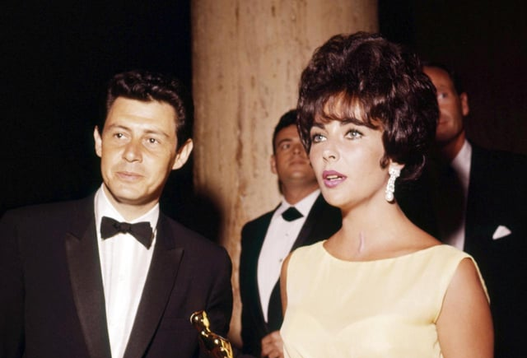
5. For which film did Elzabeth Taylor win an Oscar for leading actress
Butterfield 8
Notes:
Eddie Fisher, husband no.

Slide 14
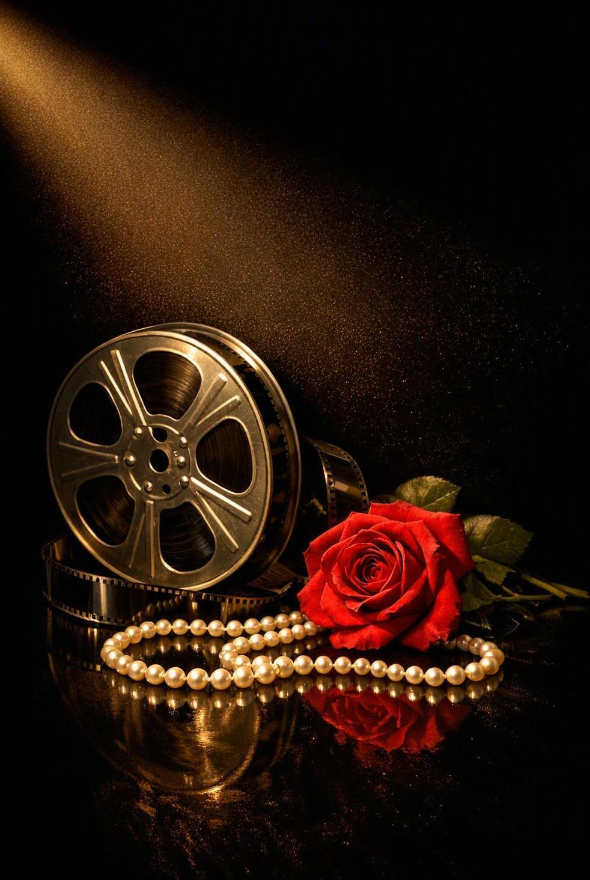
BUtterfield 8 & Elizabeth Taylor
1960 MGM drama directed by Daniel Mann, from John O’Hara’s 1935 novel; the odd capitalisation echoes a New York phone exchange.
Elizabeth Taylor stars as Manhattan party girl Gloria Wandrous, opposite Laurence Harvey and her then-husband Eddie Fisher.
The role won Taylor her first Academy Award for Best Actress at the April 1961 ceremony – the answer to Question 5.
She openly disliked the film; many felt her win owed much to sympathy after her near-fatal pneumonia weeks earlier.
Made for $2.8m, it took around $10m at the box office and sealed her status as Hollywood’s biggest star.

Slide 15
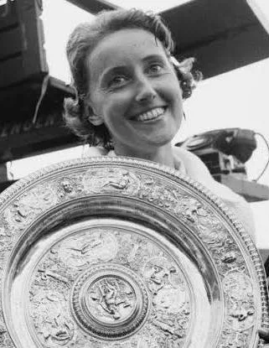
6. Who won the ladies singles title at Wimbledon?
Angela Mortimer

Slide 16
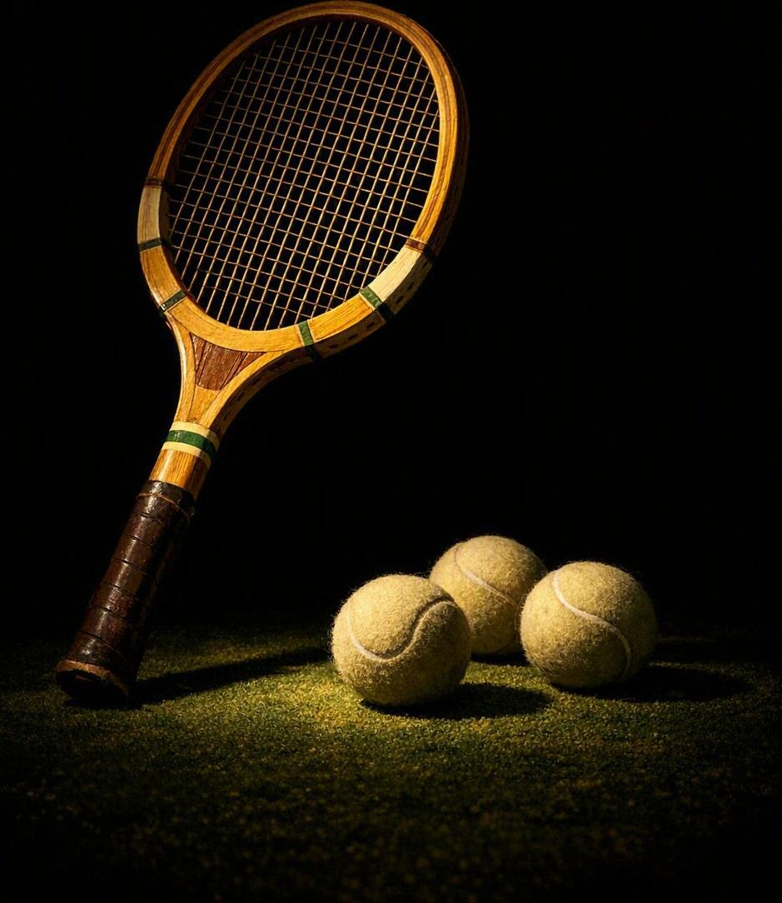
Angela Mortimer – British Tennis Champion
Born in Plymouth (1932–2025), she learned the game in Devon under coach Arthur Roberts in Torquay.
Won three Grand Slam singles titles: the French Championships (1955), the Australian Championships (1958) and Wimbledon (1961).
Her 1961 Wimbledon crown came in a famous all-British final, beating Christine Truman – the answer to Question 6.
Ranked world No. 1 in 1961; also took the 1955 Wimbledon doubles with Anne Shilcock and the 1960 Wightman Cup for Great Britain.
Partially deaf, she amassed 108 career singles titles, was made MBE and entered the Tennis Hall of Fame in 1993.

Slide 17
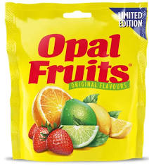
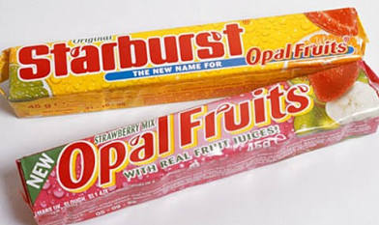
7. What popular sweets were ‘made to make your mouth water?’

Slide 18
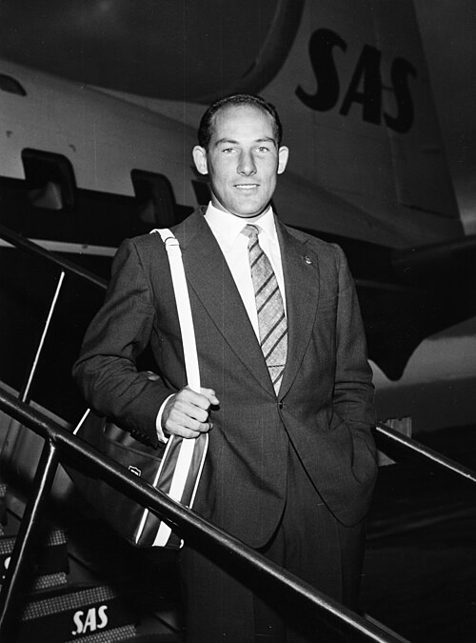
8. Who was Widely regarded as one of the greatest drivers to never win the Formula One World Drivers' Championship,
Sir Stirling Craufurd Moss
(17 September 1929 – 12 April 2020) was a British racing driver and broadcaster, who competed in Formula One from 1951 to 1961.

Slide 19
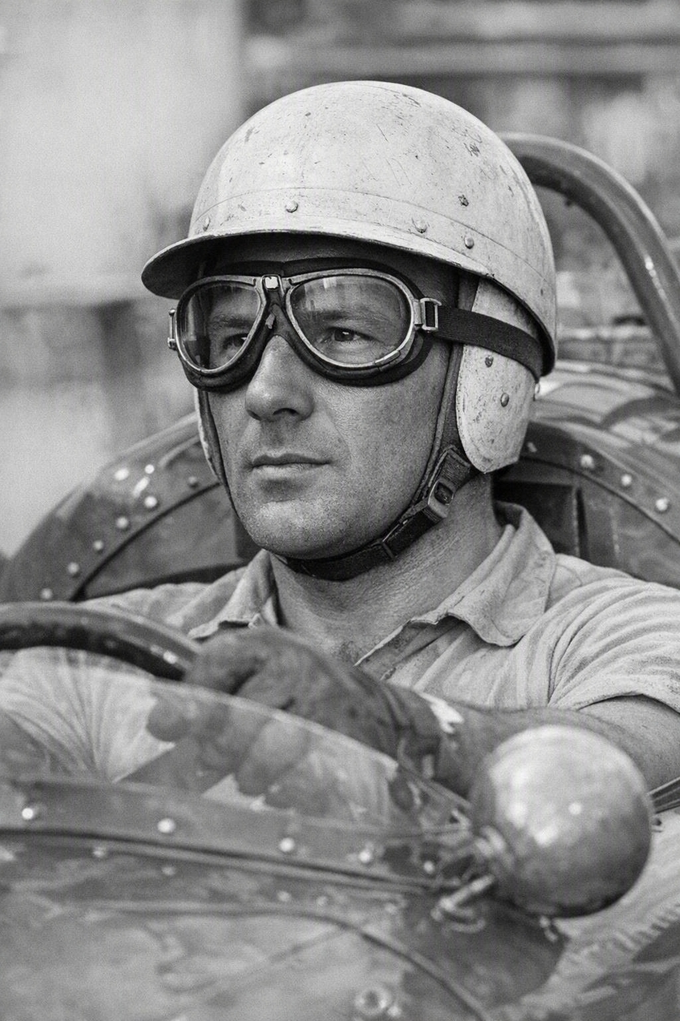
Sir Stirling Moss – Mr Motor Racing
London-born British driver (1929–2020) widely regarded as the greatest racer never to win the Formula One World Championship – the answer to Question 8.
Took 16 Grand Prix wins and finished championship runner-up four years running (1955–58), winning Monaco three times.
In 1955 he partnered Fangio at Mercedes, won his home British Grand Prix and stormed the 1,000-mile Mille Miglia at almost 98 mph.
A versatile all-rounder, he won 212 of his 529 races and famously took his last F1 win at the 1961 German Grand Prix.
Renowned for his sportsmanship, his career ended after a serious crash at Goodwood in 1962; later knighted and a Motorsports Hall of Famer.

Slide 20
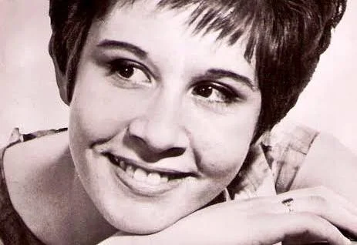
Which 14 year old scored 2 no.1 hits

Slide 21
Helen Shapiro – The Teenage Chart-Topper
East London schoolgirl (born 28 September 1946 in Bethnal Green) who became one of Britain’s most successful female singers of the early 1960s – the answer to Question 9.
Aged just 14, she scored two 1961 UK number ones – “You Don’t Know” and “Walkin’ Back to Happiness” – the youngest female artist to top the chart at the time.
Her debut single “Don’t Treat Me Like a Child” reached number three, while “Walkin’ Back to Happiness” sold over a million copies and earned her a golden disc.
Voted Britain’s top female singer in 1961 and 1962, with further hits including “Tell Me What He Said” and “Little Miss Lonely”.
In 1963, aged 16, she headlined a UK tour with a rising Beatles as her support act; from the 1970s she moved into jazz, gospel and musical theatre.

Slide 22
10. Which 3 nations gained independence from Britain in 1961 ?
Sierra Leone 27th April 1961
Kuwait 19th June 1961 Tanganyika 9th December 1961

